Slide 1
DISEI / ECNU summer school on Formal Verification of Trustworthy AI systems – 2024 SAT / SMT – the engines of reasoning
Ofer Strichman
The Technion, Israel

Slide 2
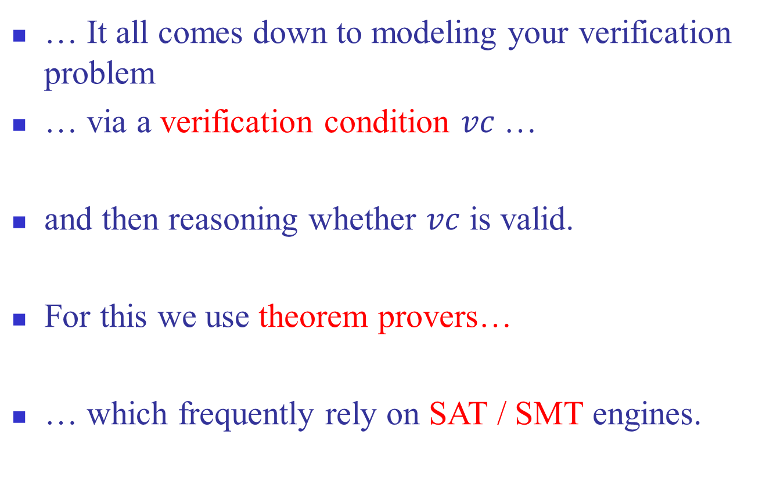
Formal Verification of Trustworthy AI systems…
… It all comes down to modeling your verification problem
… via a verification condition $vc$ …
and then reasoning whether $vc$ is valid.
For this we use theorem provers…
… which frequently rely on SAT / SMT engines.

Slide 3
Plan
Assumed prior knowledge:
propositional logic
basic logic concepts such as deduction

Slide 4
Plan
Topics of the lectures (today & tomorrow):
Conjunctive Normal Form in propositional logic
Two approaches to reasoning: enumeration and deduction
Soundness and completeness of a deduction system
Proof graphs
The resolution deduction system
... (continued on next slide)

Slide 5
Plan
Topics of the lectures (today & tomorrow):
…
SAT solving via Conflict Driven Clause Learning (CDCL)
Unsatisfiable cores
Incremental SAT solving
Extensions: Pseudo Boolean Solving (PBS) and the Constraints Satisfaction Problem (CSP)
From SAT to SMT

Slide 6
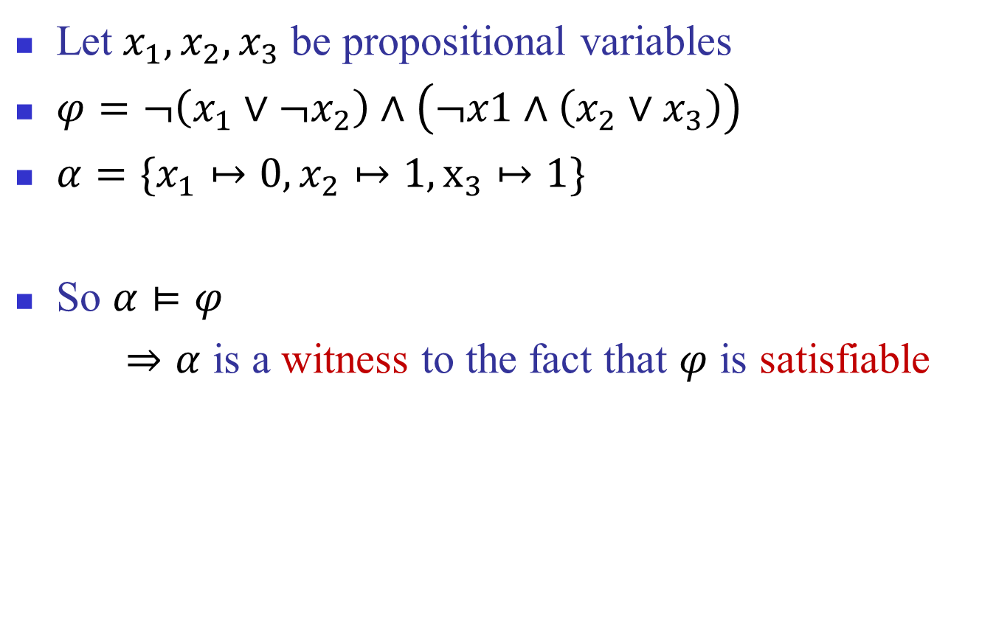
Propositional formulas
Let $x_{1},x_{2},x_{3}$ be propositional variables
$φ=¬\left(x_{1}∨¬x_{2}\right)∧\left(¬x1∧\left(x_{2}∨x_{3}\right)\right)$
$α=\{x_{1}↦0, x_{2}↦1, x_{3}↦1\}$
So $α⊨φ$
$⇒α$ is a witness to the fact that $φ$ is satisfiable

Slide 7
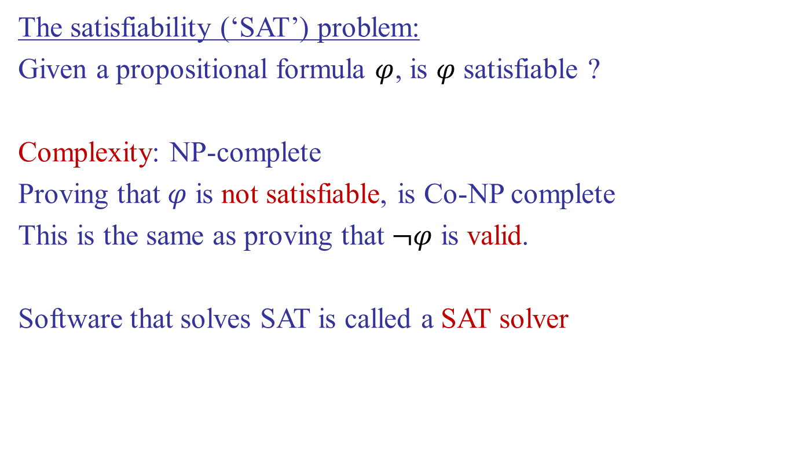
The satisfiability problem
The satisfiability (‘SAT’) problem:
Given a propositional formula $φ$, is $φ$ satisfiable ?
Complexity: NP-complete
Proving that $φ$ is not satisfiable, is Co-NP complete
This is the same as proving that $¬φ$ is valid.
Software that solves SAT is called a SAT solver

Slide 8
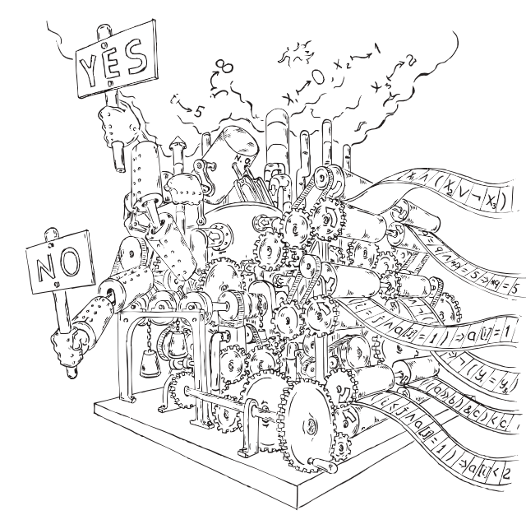
SAT is an example of a Decision Procedure

Slide 9
Other uses of SAT / SMT
SAT and SMT are used extensively in the industry
Not just for formal methods !
SAT is the ultimate solver for NP-C problems and combinatorial optimization problems.
Scheduling
Planning
Cryptography
Math number-theory problems (e.g., the Pythagorean triples problem)
…
Notes:
Can we colour the natural numbers 1, 2, 3, ... with two colours, say blue and red, such that there is no monochromatic Pythagorean triple?

Slide 10
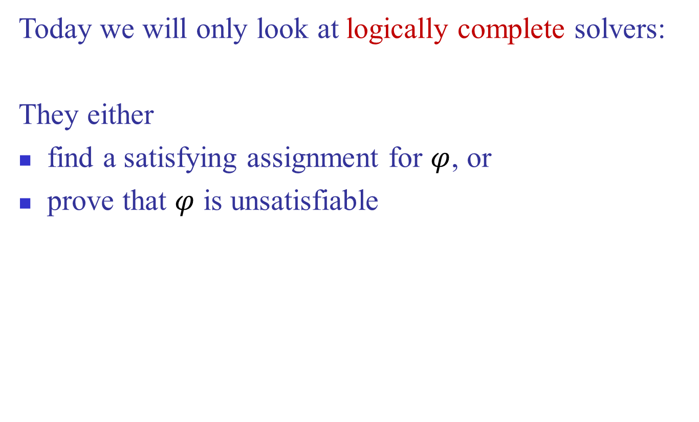
The satisfiability problem
Today we will only look at logically complete solvers:
They either
find a satisfying assignment for $φ$, or
prove that $φ$ is unsatisfiable

Slide 11

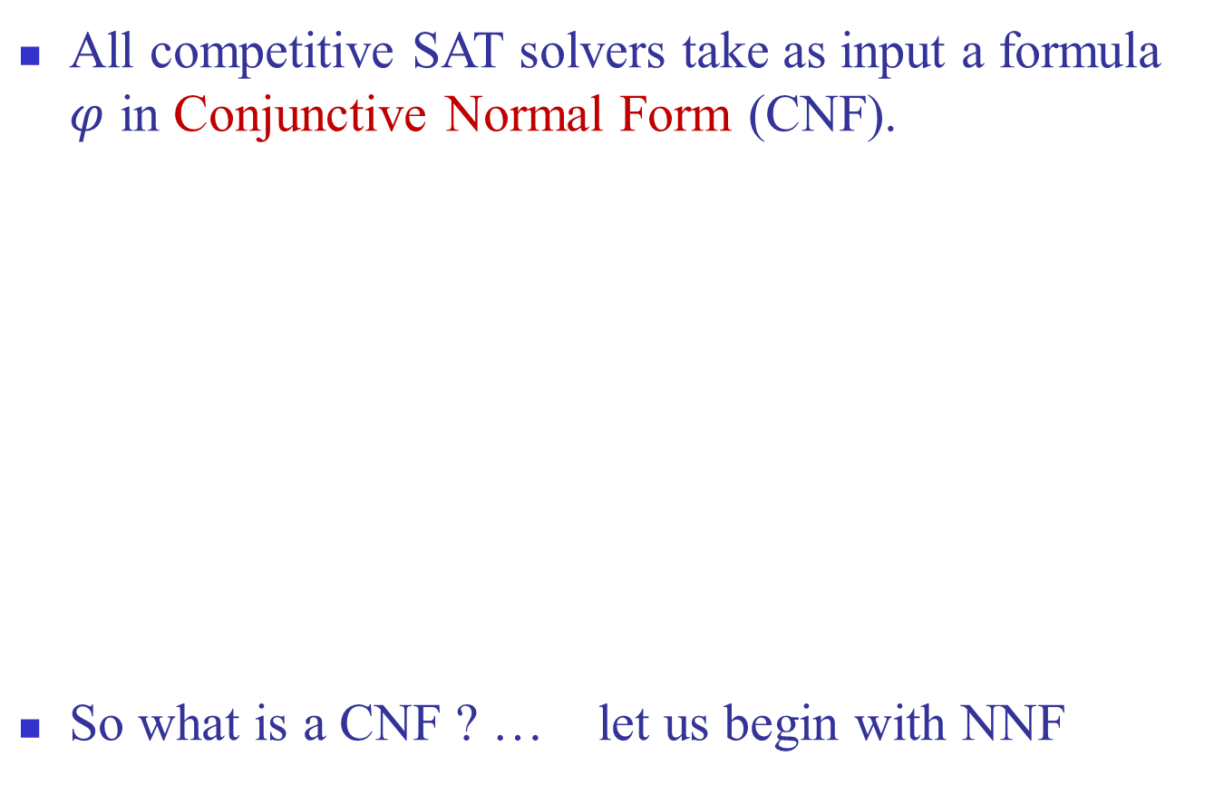
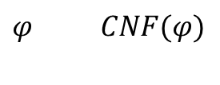
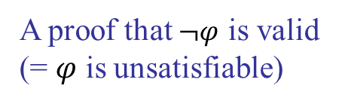
Normal forms
All competitive SAT solvers take as input a formula $φ$ in Conjunctive Normal Form (CNF).
So what is a CNF ? … let us begin with NNF
$α$, such that $α⊨CNF(φ)$
SAT
solver
$$φ CNF(φ)$$
A proof that $¬φ$ is valid
(= $φ$ is unsatisfiable)

Slide 12
Negation Normal Form (NNF)
Definition: A formula is said to be in Negation Normal Form (NNF) if it only contains :, Æ and Ç connectives and only atoms can be negated.
Examples:
φ₁ = :(A Ç :B) is not in NNF
φ₂ = :A Æ B is in NNF

Slide 13
Converting to NNF
We can convert prop. formulas to NNF in linear time:
Eliminate all connectives other than Æ, Ç, :
Use De Morgan and double-negation rules to push negations to the right
Example: φ = :(A ! :B)
Eliminate ‘!’: φ = :(:A Ç :B)
Push negation using De Morgan: φ = (::A Æ ::B)
Use Double negation rule: φ = (A Æ B)

Slide 14
Conjunctive Normal Form (CNF)
Definition: A formula is said to be in Conjunctive Normal Form (CNF) if it is a conjunction of clauses.
Example of a CNF formula:
φ = (A Ç :B Ç C) Æ (:A Ç D) Æ (B)
CNF is a special case of NNF
clause
clause
clause

Slide 15
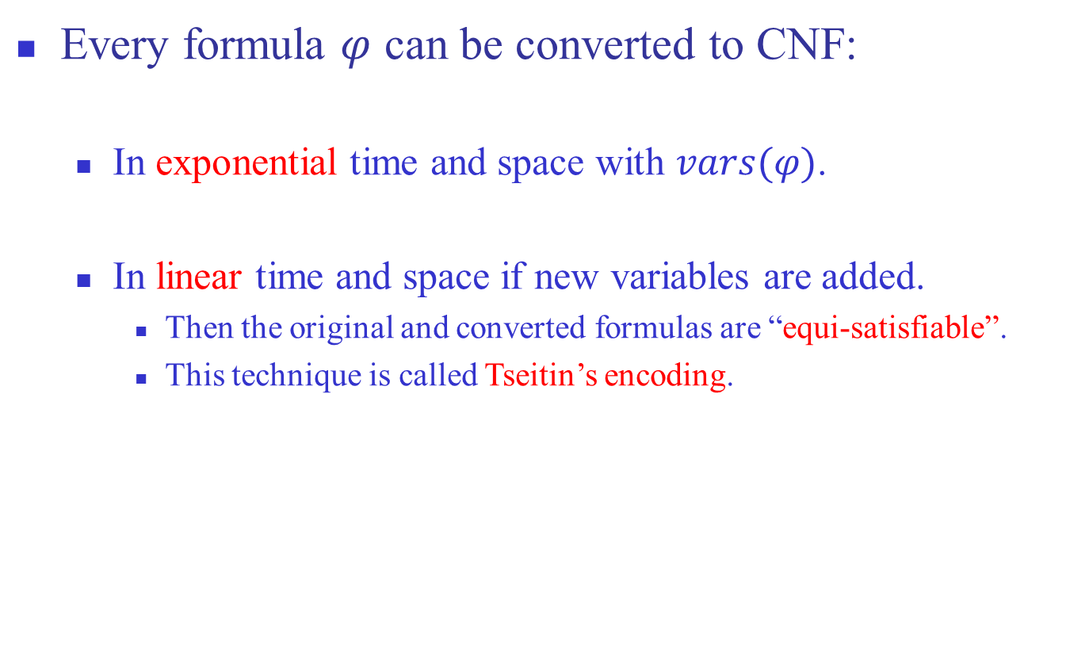
Converting to CNF
Every formula $φ$ can be converted to CNF:
In exponential time and space with $vars(φ)$.
In linear time and space if new variables are added.
Then the original and converted formulas are “equi-satisfiable”.
This technique is called Tseitin’s encoding.

Slide 16
Converting to CNF: Tseitin’s encoding
Consider the formula φ = (A ! (B Æ C))
The parse tree:
Associate a new auxiliary variable with each gate.
Add constraints that define these new variables.
Finally, enforce the root node.
!
a₁
A
Æ
a₂
B
C

Slide 17
Converting to CNF: Tseitin’s encoding
Need to satisfy:
(a₁ $ (A ! a₂)) Æ
(a₂ $ (B Æ C)) Æ
(a₁)
Each such constraint has a CNF representation with 3 or 4 clauses.
!
a₁
A
Æ
a₂
B
C

Slide 18
Converting to CNF: Tseitin’s encoding
Need to satisfy:
(a₁ $ (A ! a₂)) Æ
(a₂ $ (B Æ C)) Æ
(a₁)
First: (a₁ Ç A) Æ (a₁ Ç :a₂) Æ (:a₁ Ç :A Ç a₂)
Second: (:a₂ Ç B) Æ (:a₂ Ç C) Æ (a₂ Ç :B Ç :C)

Slide 19
Converting to CNF: Tseitin’s encoding
Let’s go back to φ_{n} = (x₁ Æ y₁) Ç (x₂ Æ y₂) Ç ☹ Ç (x_{n} Æ y_{n})
With Tseitin’s encoding we need:
2n auxiliary variables a₁,…,a_{2n}.
Each adds 3 constraints.
Top clause: (a₁)
Hence, we have
6n + 1 clauses, instead of 2^{n}.
4n variables rather than 2n.
a₁
Ç
a_{n+1}
a₂
Æ
Ç
a₃
x₁
y₁
a_{n+2}
Ç
Æ
x₂
y₂

Slide 20

What now?
Time to solve SAT.
… but recall that we are also interested in finding proofs when $φ$ is unsatisfiable.

Slide 21
Two classes of algorithms for validity
Two classes of algorithm for finding out:
Enumeration of possible solutions.
Deduction

Slide 22
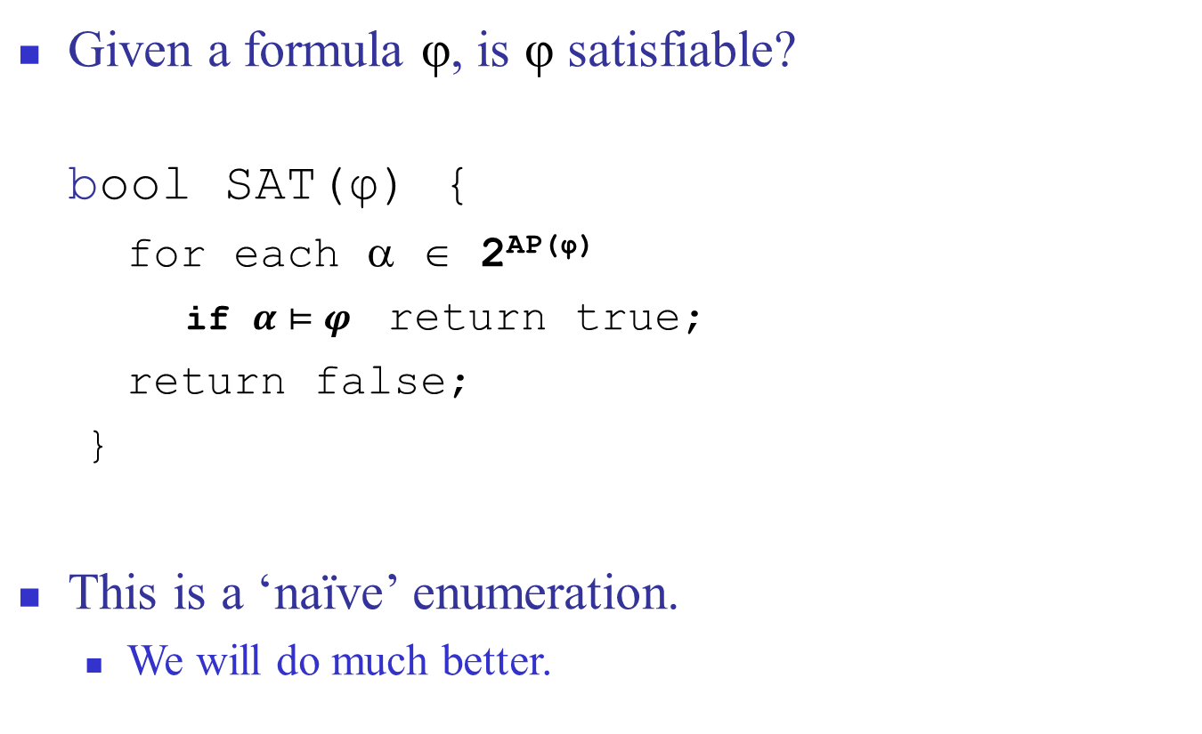
1. Enumeration
Given a formula φ, is φ satisfiable?
bool SAT(φ) {
for each α ∈ 2^{AP(φ)}
if $α⊨φ$ return true;
return false;
}
This is a ‘naïve’ enumeration.
We will do much better.

Slide 23
2. Deduction
Inference rules: Antecedents Consequent
Examples:
A ! B B ! C A ! C
A ! B A B
(rule-name)
(trans)
(M.P.)

Slide 24
Proofs
A proof uses a given set of inference rules and axioms. This set is called the proof system.
A proof is a list of propositions, each of which is a premise or can be deduced from previous propositions via the proof system.
Let H be a proof system.
Γ `_{H} φ means: there is a proof of φ in system H whose premises are included in Γ
`_{H} is called the provability relation.

Slide 25
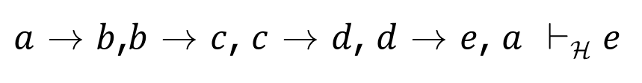
Example
Let H be the proof system comprised of the rules Trans and M.P. that we saw earlier.
Does the following relation hold?
$a$ ! $b$,$b$ ! $c$, $c$ ! $d$, $d$ ! $e$, $a$ `_{H} $e$

Slide 26
Deductive proof: example
a ! b, b ! c, c ! d, d ! e, a `_{H} e
1. a ! b premise
2. b ! c premise
3. a ! c 1,2,Trans
4. c ! d premise
5. d ! e premise
6. c ! e 4,5, Trans
7. a ! e 3,6, Trans
8. a premise
9. e 7,8.M.P.

Slide 27
Proof graph (DAG)
a ! b b ! c c ! d d ! e
(trans)
(trans)
a ! c
c ! e
(trans)
a
a ! e
(M.P.)
e
Roots: premises

Slide 28
Proofs
The problem: ` is a relation defined by syntactic transformations of the underlying proof system.
For a given proof system H,
does ` conclude “correct” conclusions from premises ?
Can we conclude all true statements with H?
Correct with respect to what ?
With respect to the semantic definition of the logic. In the case of propositional logic truth tables gives us this.

Slide 29
Soundness and completeness
Let H be a proof system
Soundness of H: if `_{H} φ then ² φ
Completeness of H : if ² φ then `_{H} φ
How to prove soundness and completeness ?

Slide 30
Example: Hilbert axiom system (H)
Let H be (M.P) + the following axiom schemas:
(H1)
A ! (B ! A)
(H2)
((A !(B ! C)) !((A! B)!(A! C))
(H3)
(:B ! :A) ! (A ! B)
H is sound and complete

Slide 31
Soundness and completeness
To prove soundness of H, prove the soundness of its axioms and inference rules (easy with truth-tables). For example:
Completeness – harder, but possible.
A ! (B ! A) | B | A
1 | 0 | 0
1 | 1 | 0
1 | 0 | 1
1 | 1 | 1

Slide 32
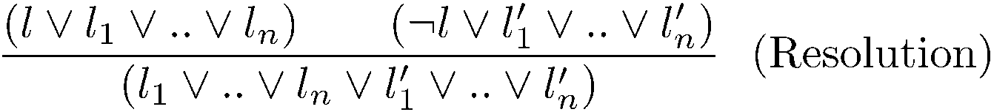
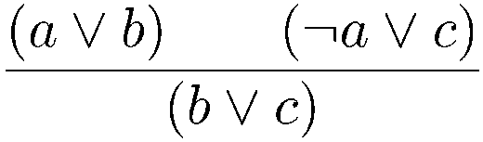
The resolution inference system
The resolution inference rule for CNF:
Example:

Slide 33
Proof by resolution
Let ϕ = (1 3) Æ (-1 2 5) Æ (-1 4) Æ (-1 -4) Æ (1 -2)
We’ll try to prove ϕ → (3 5)
(1 3)
(-1 2 5)
(2 3 5)
(1 -2)
(-1 4)
(-1 -4)
(1 3 5)
(-1)
(3 5)

Slide 34
Resolution
Resolution is a sound and complete inference system for CNF
If the input formula is unsatisfiable, there exists a proof of the empty clause

Slide 35
Example
Let ϕ = (1 3) Æ (-1 2) Æ (-1 4) Æ (-1 -4) Æ (1 -2) Æ (-3)
(1 3)
(-1 2)
(2 3)
(1 -2)
(-1 4)
(-1 -4)
(1 3)
(-1)
(3)
(-3)
()

